Slide 1
Adidas Sales Analysis
Problem Statement, Insights and Recommendations
Prepared By
Oyekan Oluwole

Slide 2
TABLE OF CONTENTS
Project Overview/Objectives
Problem Statement
Chart Requirements
Key Findings
Insights and Recommendations.

Slide 3
PROJECT OVERVIEW
Through this PowerBI-driven analysis, Adidas aims to empower its decision makers with the data driven insights, fostering strategic growth and competitiveness in the dynamic sports and athletic industry.
Enhanced understanding of sales dynamics and performance driven.
Identification of geographical areas with high and low potential sales.
Insights into product performance, aiding in inventory and marketing decisions
Informed pricing and margin strategies for improved profitability.
Actionable recommendations for optimizing sales and profit across various dimensions.

Slide 4
Problem Statement
Key Performance Indicators(KPIs)
Total Sales Analysis
-Understand the overall sales performance of Adidas over time
Profitability Analysis
-Evaluate the total profit generated by Adidas across different dimensions.
Sales Volume Analysis
-Examine the total units sold to gain insights into product demands
Pricing Strategy
-Determine the average price per unit to access the pricing strategy
Margin Analysis
-Evaluate the average margin to understand the overall profitability of sales.

Slide 5
Charts Requirement
Total Sales By Month(Area Chart)-Visualize the monthly distribution of total sales to identify peak periods.
Total Sales By State(Filled Map)-Geographically represent total sales across different states using a filled map.
Total Sales By Region(Donut Chart)-Use a donut chart to represent the contribution of different regions to total sales.
Total Sales By Product(Bar Chart)- Analyze the sales distribution among various Adidas products using a bar chart.
Total Sales By Retailer(Bar Chart)-visualize the contribution of different retailers to total sales using a bar chart

Slide 6
KEY FINDINGS
Total Sales-$900M
Operating Profit-$332M
Sales Volume-$2M
Price Per Unit-$45
Operating Margin-42%
Product Contribution: A bar chart depicting product category contributions, with Men’s Street Footwear dominating.
Retailer Breakdown: A bar chart ranking retailer performance, with West Gear leading the chart.
Trend Analysis: An Area chart showing monthly sales, highlighting July and August peaks.

Slide 7
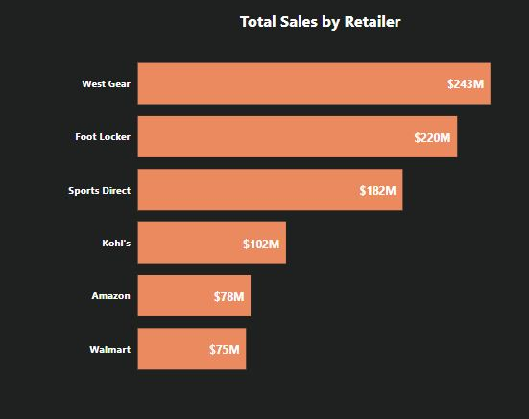
Top Performing Retailer
West Gear leads as the top retailer, generating $242,964,333 in total sales.

Slide 8
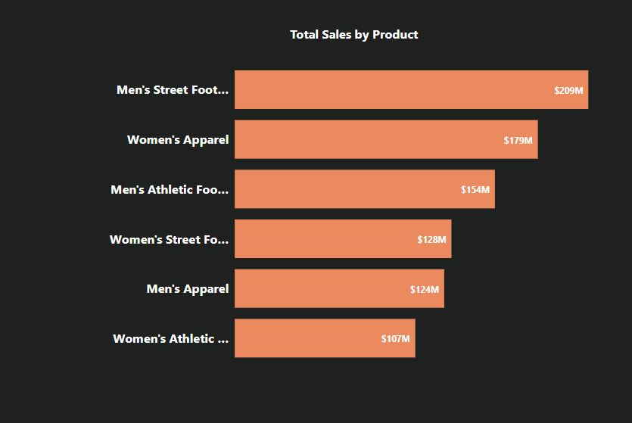
Total Sales By Product
Highest Grossing Product
Men’s Street Footwear takes the spotlight as the highest-grossing product, contributing $208,626,244 to total sales.

Slide 9
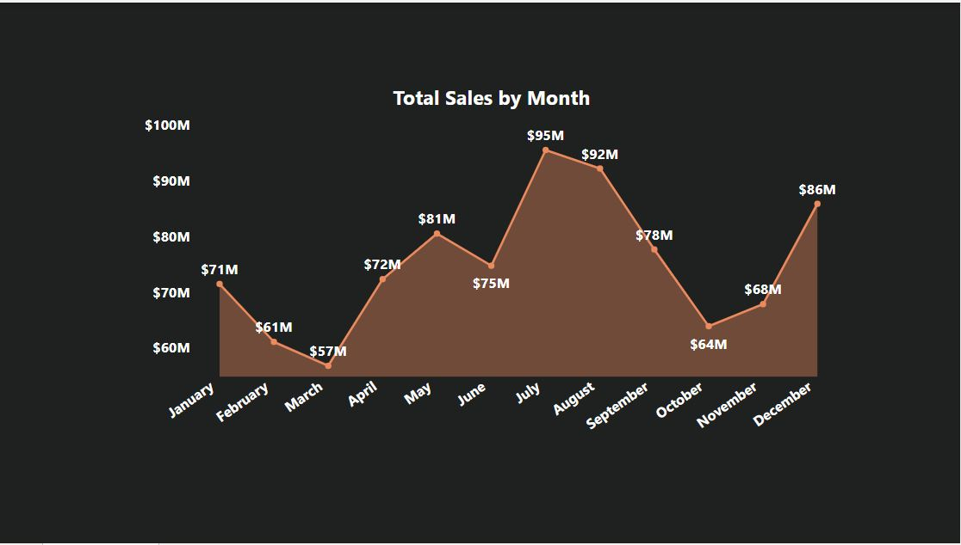
Total Sales By Month
The Peak Periods are July and Augiust

Slide 10
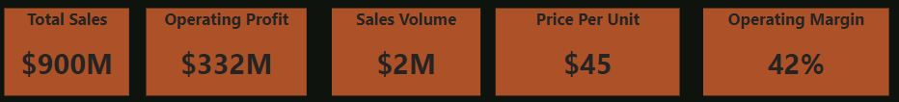
Data Storytelling: Business Insights Overview
Key Performance Metrics
Total Sales: The business achieved an impressive $900M in total sales, reflecting robust market presence and strong customer demand.
Operating Profit: A noteworthy $332M operating profit was realized, indicating a healthy profitability framework.
Sales Volume: With 2M units sold, the business demonstrates significant product demand.
Price Per Unit: The average price per unit stands at $45, signifying competitive pricing in the market.
Operating Margin: An outstanding 42% operating margin highlights the efficiency of cost management and revenue generation strategies.

Slide 11
Top Performing Retailer
West Gear leads as the top retailer, generating $242,964,333 in total sales.
This retailer's dominance could be attributed to effective marketing, customer loyalty,
or superior product assortment.
Highest Grossing Product
Men’s Street Footwear takes the spotlight as the highest-grossing product, contributing $208,626,244 to total sales.
This category's strong performance signals a trend in consumer preferences for stylish and functional men’s footwear.

Slide 12
DATA STORY THEMES
Profitability and Efficiency:
The 42% operating margin and significant operating profit reflect strong cost-control measures and strategic pricing.
This financial health provides opportunities for reinvestment in growth areas.
Retailer and Product Insights:
West Gear and Men’s Street Footwear are standout performers, signaling key areas to scale or replicate success.
Focused marketing and inventory optimization for these segments can yield further gains.
Seasonality:
The sales surge in July and August offers an opportunity to strengthen summer campaigns and inventory planning.

Slide 13
Recommendations
Expand High-Performing Product Lines:
Invest in product innovation and marketing for Men’s Street Footwear to capitalize on its market appeal.
Explore complementary products to cross-sell within the footwear category.
Strengthen Partnership with West Gear:
Enhance collaborations with West Gear, leveraging their success to pilot new launches and exclusive collections.
Use their sales insights to refine retailer strategies for other partners.
Leverage Seasonality:
Develop targeted promotions and inventory strategies for July and August to maximize seasonal sales spikes.
Consider launching campaigns earlier to capture pre-season interest.
Optimize Price-Performance:
With a $45 price per unit, ensure products maintain competitive pricing without compromising the operating margin.
Assess the feasibility of premium pricing for high-demand categories like Men’s Street Footwear.

Slide 14
THANK YOU

